Slide 1
Using Vortex on FPGA
https://github.com/vortexgpgpu/vortex_tutorials
Presenter: Liam Cooper
Notes:
1

Slide 2
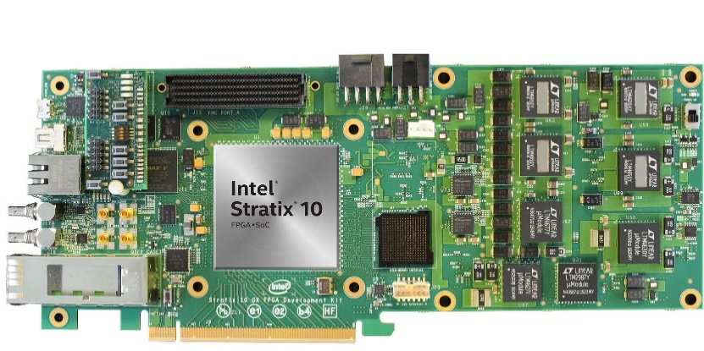
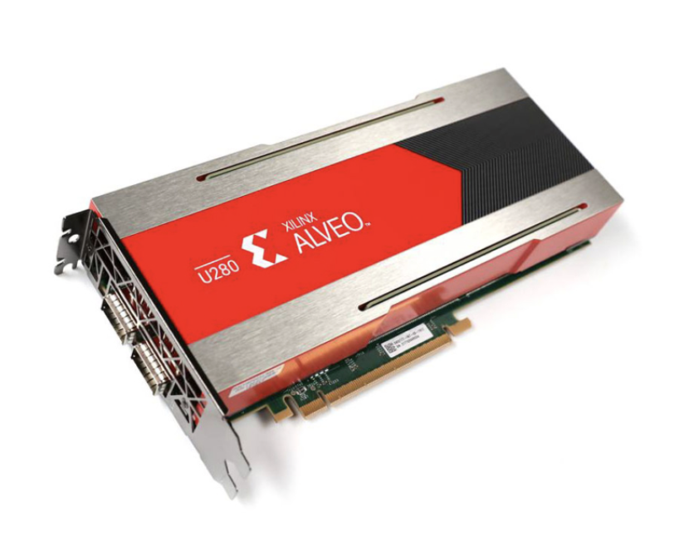
Overview
Supported platforms
Intel Quartus, OPAE
Xilinx XRT
Yosys
Supported FPGAs
Altera Arria 10, Stratix 10
Xilinx Alveo U50, U55, U250, U280
Xilinx Versal VCK5000
Configurations synthesized on Stratix 10
8 cores, each with 32 warps and 32 threads per warp
16 cores, each with 8 warps and 8 threads per warp
Notes:
2

Slide 3
Synthesis for Xilinx FPGAs
Requires Xilinx XRT to be installed
The directory hw/syn/xilinx/xrt contains makefile for synthesis
Vortex hardware configuration and target Xilinx platform passed to makefile
Xilinx hardware emulation supported
vitis_analyzer used for viewing area and timing reports
To run a program on Vortex via FPGA, use blackbox script
Specify xrt for driver option
Notes:
3

Slide 4
Synthesis for Altera FPGAs
Requires Intel Quartus and OPAE to be installed
The directory hw/syn/altera/opae contains makefile for synthesis
Vortex hardware configuration and FPGA family name passed to makefile
Scripts for generating area, power, and timing reports
To run a program on Vortex via FPGA, use blackbox script
Specify opae for driver option
Notes:
4

Slide 5
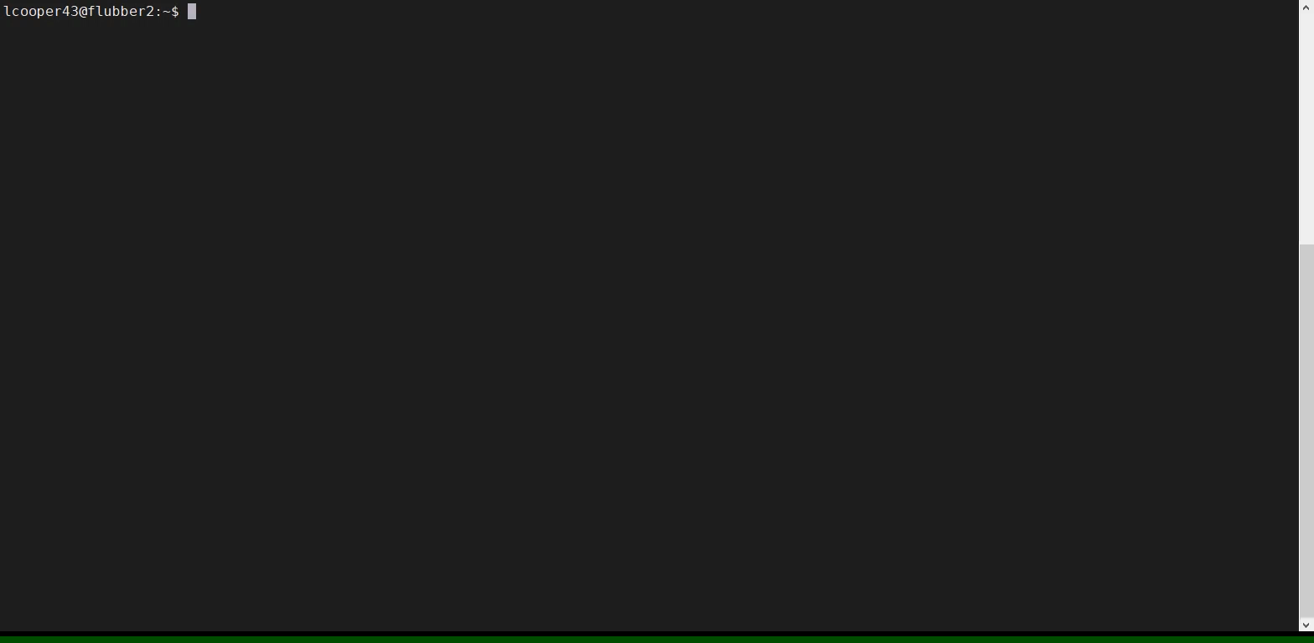
Notes:
5

Slide 6
Vortex Tutorial Assignments
https://github.com/vortexgpgpu/vortex_tutorials
Presenter: Liam Cooper
Notes:
6

Slide 7
Pre-exercise Setup: Remote Account in Browser
Log into rg-simulation.crnch.gatech.edu/jupyter with Github login
Click “Launch my server"
Set up the environment with toolchain_env.sh
Build Vortex with make –j2
Test Vortex with blackbox.sh
./ci/blackbox.sh --cores=2 --app=demo
Detailed setup instructions in the tutorial repo
Will be available until the end of the conference
Notes:
7

Slide 8
Pre-exercise Setup: Docker
Download the Dockerfile from the tutorial repo
Build a Docker image from the Dockerfile
Construct and run a container from the Docker image
Build Vortex
Test Vortex with blackbox.sh
./ci/blackbox.sh --cores=2 --app=demo
Detailed setup instructions in the tutorial repo
Notes:
8

Slide 9
Blackbox
Vortex's main test driver
Arguments
Clusters, cores, warps, threads
L2cache, L3cache
Driver
rtlsim, simx, xrt, opae
Debug
Perf
App
Application to run
Args
Arguments to the application
Notes:
9

Slide 10
7 Tutorial Assignments
Vortex tutorial assignments
Designed to cover various aspects of Vortex
Warp efficiency performance counter
Assignments 1 & 2
Software prefetching
Assignments 3 & 4
Custom instruction for computing dot product
Assignments 5 & 6
Debugging Vortex
Assignment 7
Odd assignments: Simx (cycle-level sim)
Even assignments: RTL
Notes:
10

Slide 11
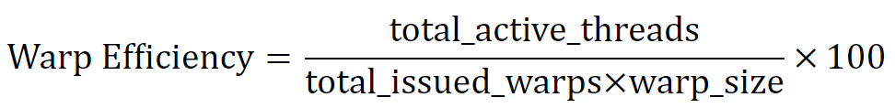
Assignment 1 & 2
Add a new performance counter for warp efficiency
Implement and use performance counters for total active threads and total issued warps
Reserve and register the CSR addresses for the new counters
Implement the logic for the total active threads and total issued warps counters
Expose the counters in the runtime for use in calculating the warp efficiency
Notes:
11

Slide 12
Assignment 3 & 4
Software prefetching
Extend the tag in the cache to include a prefetch bit
Add three new performance counters
Number of unique prefetch requests to main memory
Number of unused prefetched blocks
Number of late prefetches
Verify your implementation with the prefetch kernel
Notes:
12

Slide 13
Assignment 5 & 6
Dot product acceleration
Add a new RISC-V custom instruction for computing the integer dot product
Extend the ISA and add a matrix multiply unit in HW
VX_DOT8 calculates the dot product of two 4x4 vectors of int8
Implement a simple matrix multiplication GPU kernel to test your new HW extension
Notes:
13

Slide 14
Assignment 7
Debugging Vortex
Compile Vortex using the debug flag
Check the prefetch requests are generated correctly
Check requests are used or not by comparing them with demand requests
Useful to refer to while working on the assignments
Notes:
14

Slide 15
Thank you
https://github.com/vortexgpgpu/vortex_tutorials
Notes:
15

